Slide 1

CAPSTONE PROJECT
Coronavirus Tweet Sentiment Analysis
Presented By:
EDE POOJITHA
Vkr Vnb & Agk college of engineering
CSE

Slide 2
OUTLINE
Problem Statement
Proposed System/Solution
System Development Approach
Algorithm & Deployment
Result
Conclusion
Future Scope
References

Slide 3
Problem Statement
This challenge asks us to build a classification model to predict the sentiment of COVID-19 tweets.The tweets have been pulled from Twitter and manual tagging has been done then. The names and usernames have been given codes to avoid any privacy concerns.

Slide 4
Proposed SOLUTION
Data Preprocessing:
Clean the text data by removing noise (punctuation, special characters, numbers).
Eliminate Twitter handles (@user) and links.
Remove common hashtags like #coronavirus and #covid-19, which appear across all sentiments.
Stop words (e.g., “is,” “an,” “the”) can be removed.
Apply stemming to reduce words to their root form.
Feature Extraction:
Extract relevant features from the preprocessed text data.
Consider techniques like TF-IDF (Term Frequency-Inverse Document Frequency) or word embeddings (e.g., Word2Vec, GloVe).
These features will serve as input to the classification model.
Model Selection and Training:
Experiment with various machine learning (ML) models.
Evaluate performance using metrics like accuracy, precision, recall, and F1-score.
ML classifiers: Logistic Regression, Random Forest, Support Vector Machines.
Importing Libraries & Data Inspection
Sentiment Classification:
Categorize tweets into positive, negative, or neutral sentiment classes.
Early detection of COVID-19 sentiments allows better understanding and handling of the pandemic.

Slide 5
System Development Approach
Importing Libraries & Data Inspection
Pandas – Manipulation of tabular data in Dataframes
Numpy – Mathematical operations on arrays
Matplotlib – Visualization
Seaborn – Visualization • Sklearn – Data Modeling
Nltk – Pre Processing / Feature Engineering
WordCloud – Visualization

Slide 6
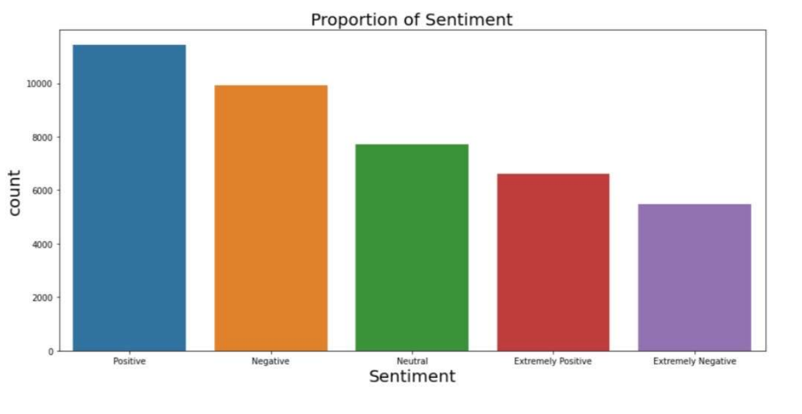
Exploratory DataAnalysis

Slide 7
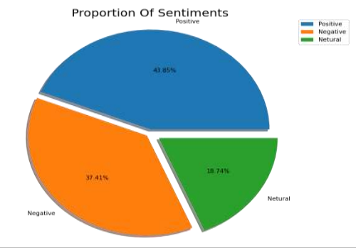
EDA Continued… New Sentiments
Sentiment, Extremely Negative Sentiment and Neutral Sentiment. So, we have replaced Extremely Positive Sentiment by Positive Sentiment and Extremely Negative Sentiment by Negative Sentiment. Now we have three types of sentiments – Positive Sentiment, Negative Sentiment and Neutral Sentiment.
The Pi Chart shows the proportion of each sentiment.
There are 43.85% Positive Sentiments,37.41%
Negative Sentiments and 18.74% Neutral Sentiments.
Positive Sentiments are having higher proportion
among all.

Slide 8

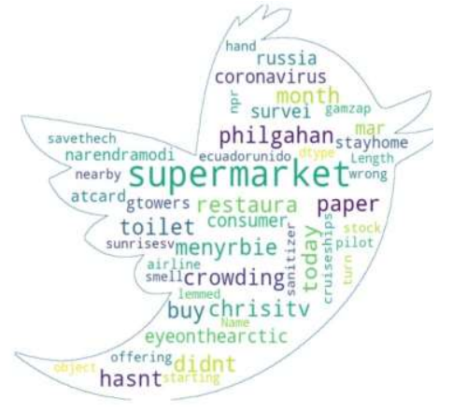
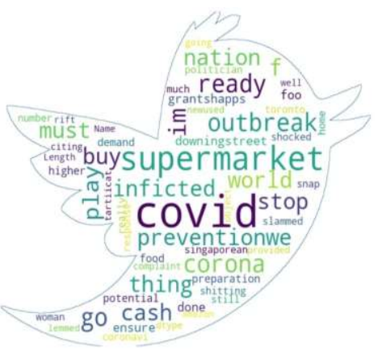
EDA Continued… Word cloud Word Clouds are visual displays of text data – simple text analysis. Word Clouds display the most prominent or frequent words in a body of text.
1. Positive Words
2. Neutral Word
3.Negative Word

Slide 9
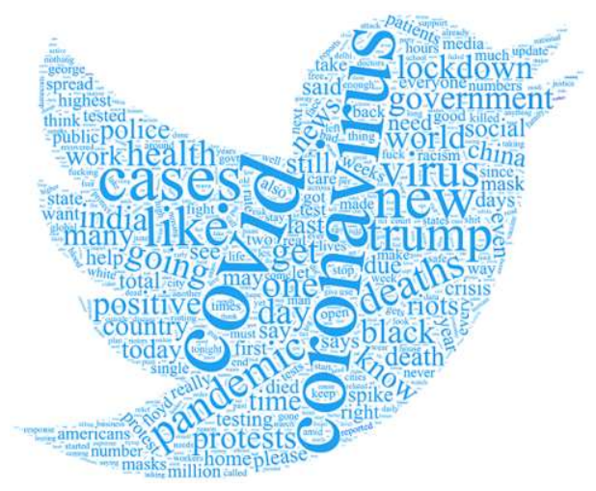
Algorithm &Deployment Model Traininning Model Used
• Logistic Regression with Grid Search CV
• Decision Tree Classifier
• XG Boost Classifier
• KNN Classifier
• SVM Classifier

Slide 10
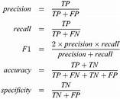
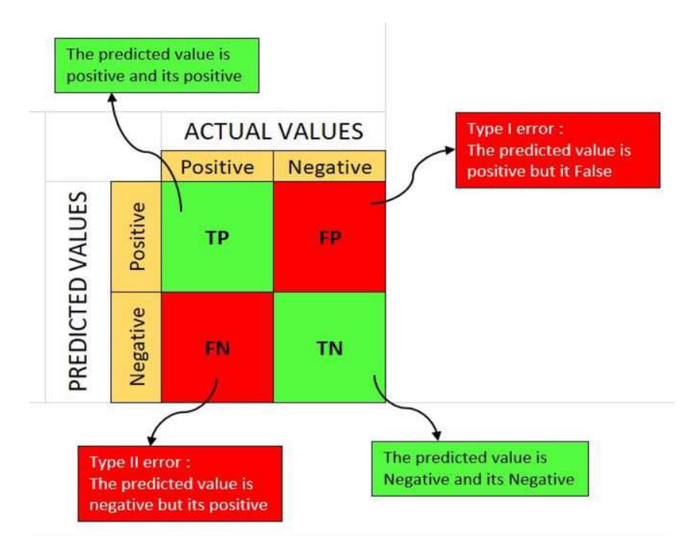
Performance metrics of classification models

Slide 11
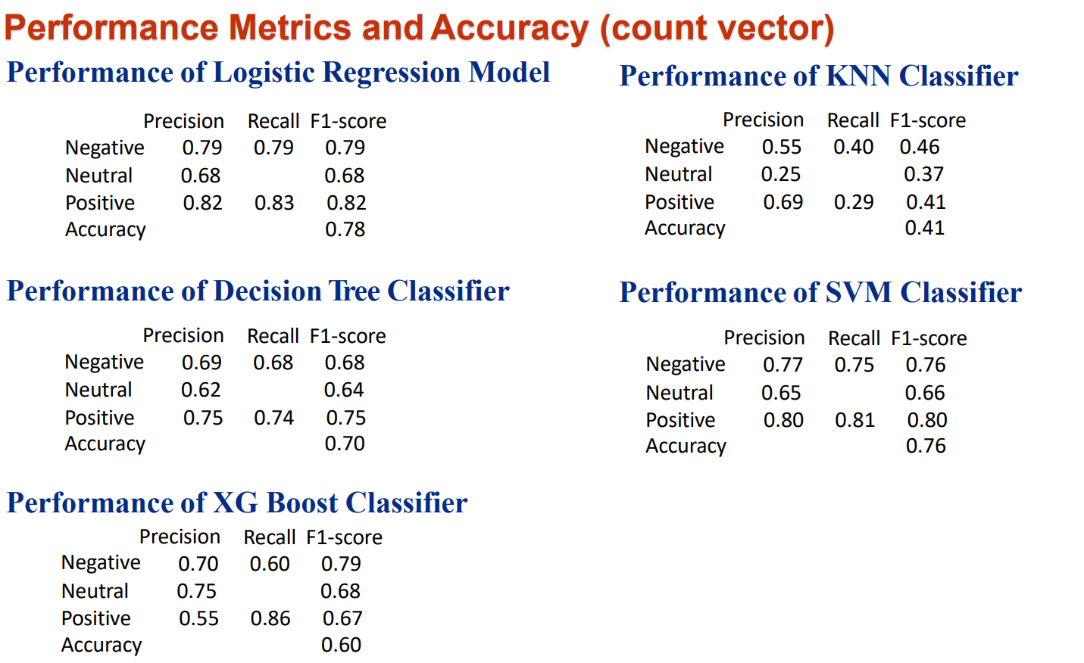
Result

Slide 12
Conclusion
We applied 5 models namely, Logistic Regression with Grid Search CV, Decision Tree Classifier, XG Boost, KNN, and SVM Classifier for both Count VectorAnd TF ID Vectorization techniques.
We conclude that the machine is generating the best results for the Logistic Regression with Grid Search CV (count vectorizer) model with an Accuracy of 78.28% followed by the Logistic Regression with Grid Search CV (TF/ID vectorizer) model with an Accuracy of 77.43%.
Also, we observed that no overfitting is seen for the data, and we can deploy this model.
The sentiments of future tweets can be easily predicted using this model.
Even being in the unprecedented situation of CoVid-19, people's positive sentiments outnumbered negative sentiments. However, negative sentiments also has a significant chunk which various Government agencies, NGOs, etc. can use to help boost the morale of the people and then in future repeat the analysis and comparing it with the present sentimental analysis to gauge the impact of the initiatives on the ground.

Slide 13
Future Scope
Coronavirus Tweet Sentiment Analysis includes data collection, preprocessing, feature extraction, and sentiment classification. It also involves machine learning models, temporal analysis, geospatial insights, topic-specific sentiment exploration, visualization, and causal inference like
Text preprocessing.
Vectorization.
Model Training and performance improvement.

Slide 14
References
Sentiment analysis and causal learning of COVID-19 tweets prior to the rollout of vaccines:
Zhang Q, Yi GY, Chen L-P, He W (2023).
Published in PLoS ONE.
Available at: Sentiment analysis and causal learning of COVID-19 tweets prior to the rollout of vaccines¹.
National Leaders’ Usage of Twitter in Response to COVID-19: A Sentiment Analysis:
Examines how world leaders framed COVID-19 on Twitter.
Available at: National Leaders’ Usage of Twitter in Response to COVID-19: A Sentiment Analysis².
Public discourse and sentiment during the COVID-19 pandemic:
Analyzes Twitter users’ discourse and psychological reactions to COVID-19.
Available at: Public discourse and sentiment during the COVID-19 pandemic³.
Sentiment Analysis on Covid-19 Tweets:
Provides insights into sentiment analysis using COVID-19 tweet data.
Available at: Sentiment Analysis on Covid-19 Tweets

Slide 15
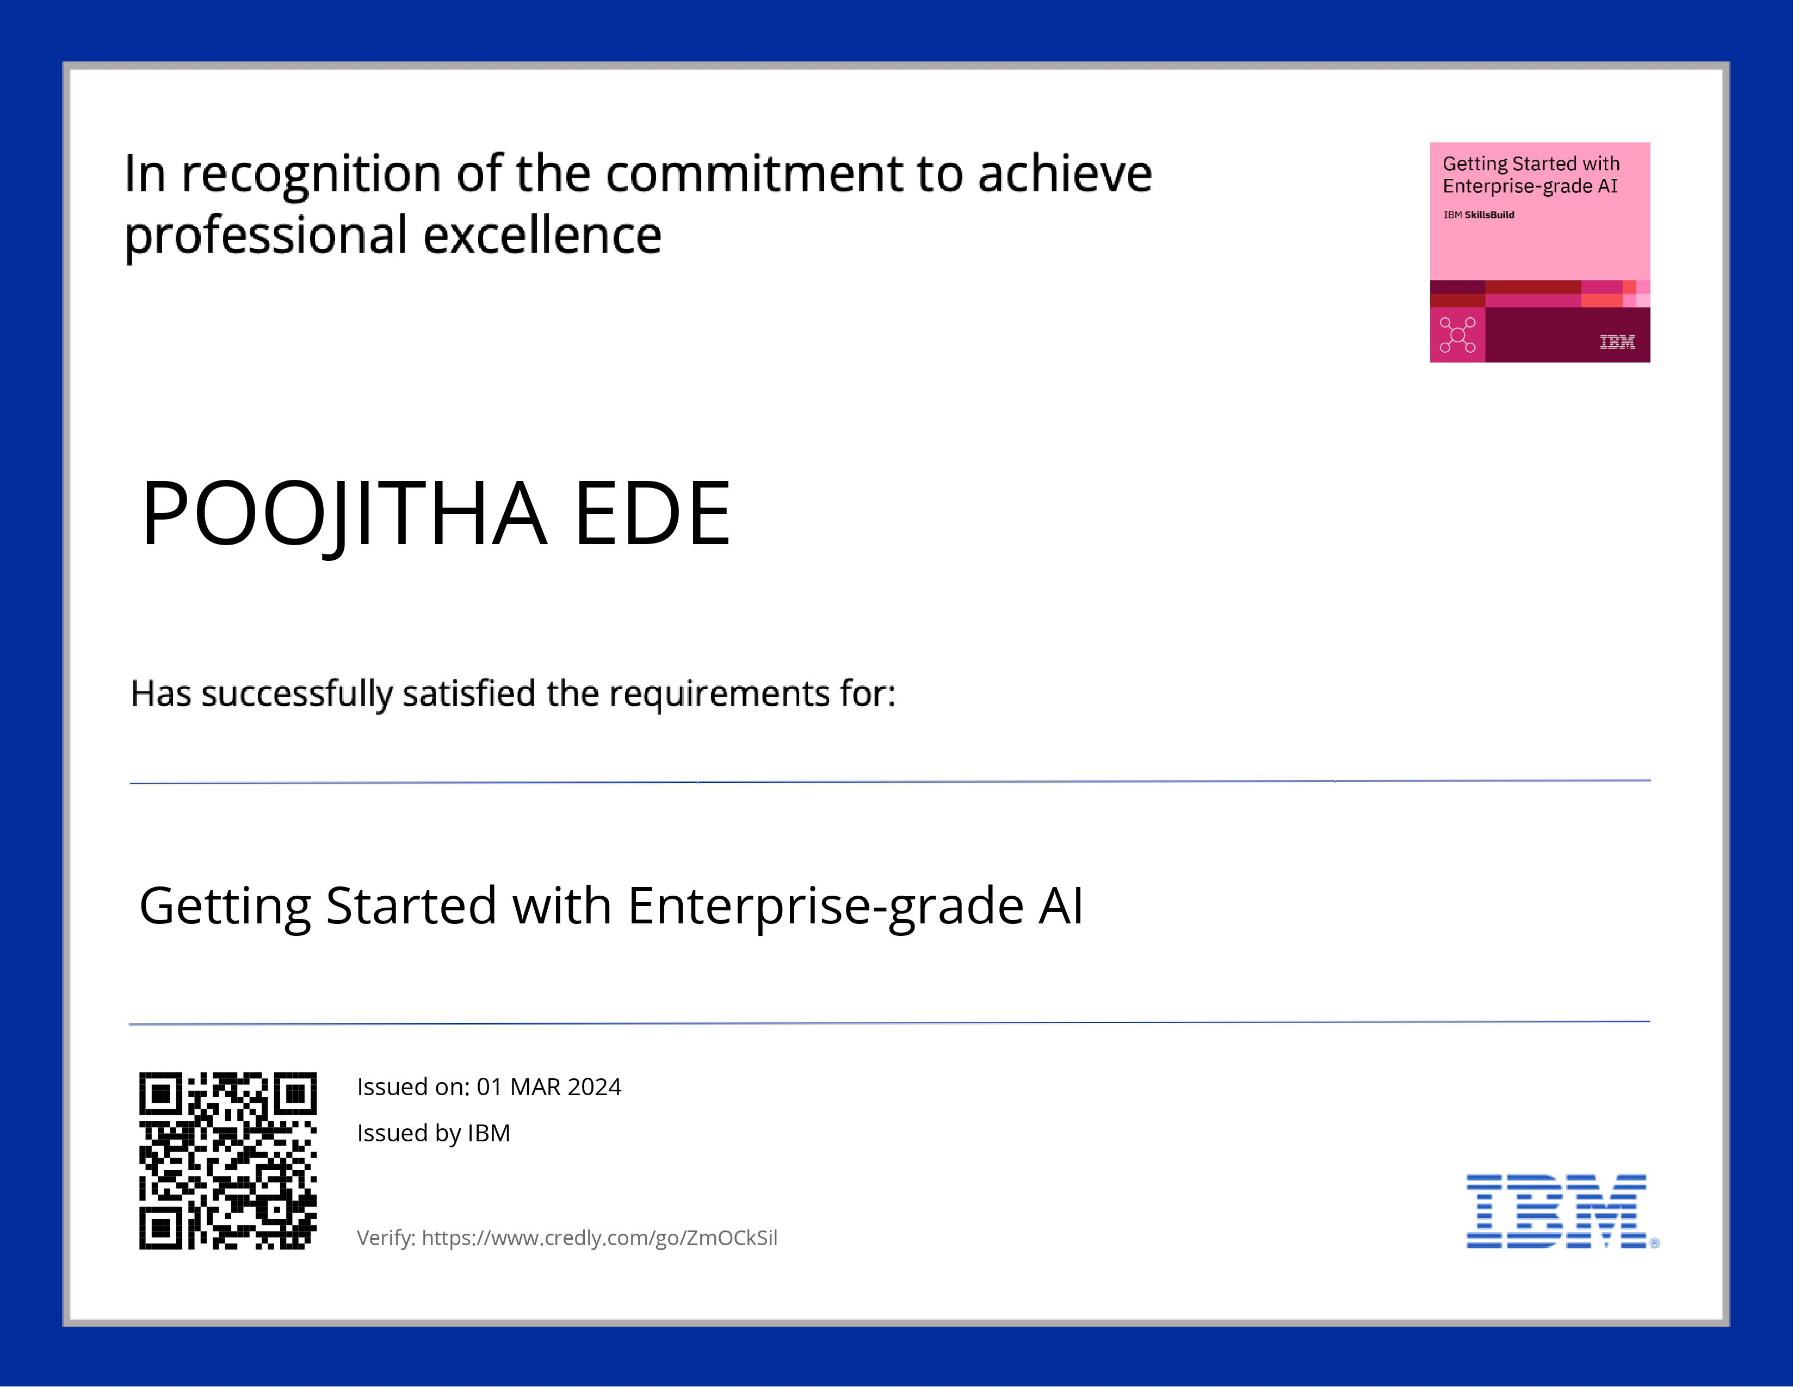
COURSE CERTIFICATE 1

Slide 16

COURSE CERTIFICATE 2

Slide 17
THANK YOU

